Slide 1
NI Daq Explorer UI

Slide 2
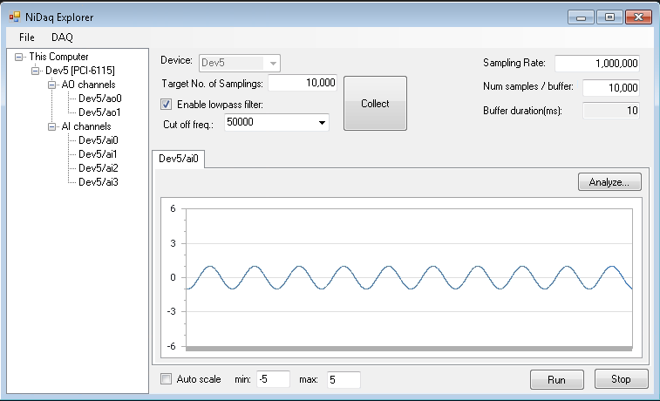
NI Daq Explorer UI (measure)
FormNiDaqExplorer
FormMeasureAI
SwiftChartCtrl
DeviceTreeCtrl
FormSwiftChart

Slide 3
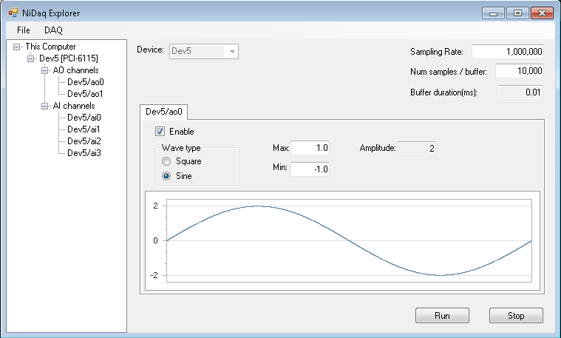
NI Daq Explorer UI (generator)
FormNiDaqExplorer
FormGenerateAO
SwiftChartCtrl
DeviceTreeCtrl
FormGeneratePerchannleAO

